Slide 1
Met Office Forecaster and Customer Requirements and Rationale
7 March 2017

Slide 2
Usefulness of 3D view
+ Improve forecasting of CMEs.
Coronagraph imagery at L1 and L5 - C2 & C3.
3D view would reduce CME timing errors from +/- 12 hrs to +/- 6 hrs (or less) ?
Heliospheric imagery on L5.
Monitor CMEs en-route - reduce timing errors to > +/- 3 hrs ?
Improve background solar wind fields for heliospheric models?
Solar wind from EUV & Mag L5 images.
+ Improve flare & CME forecasting from better sunspot analysis.
HMI Visible Imagery and Magnetogram.

Slide 3
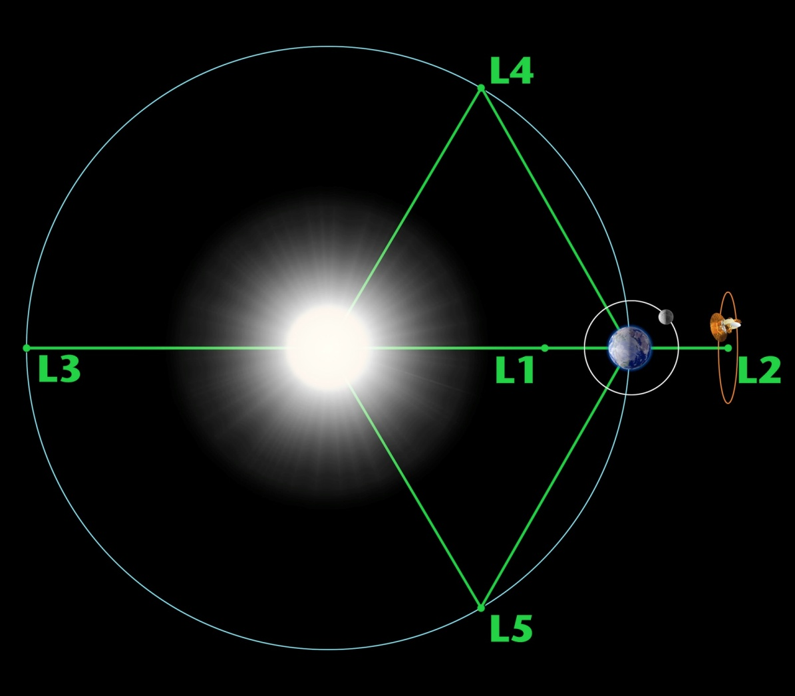
WSA ENLIL - L1 & L5
Modelling: Solar wind in heliosphere & CMEs
More observations
will improve
accuracy.

Slide 4
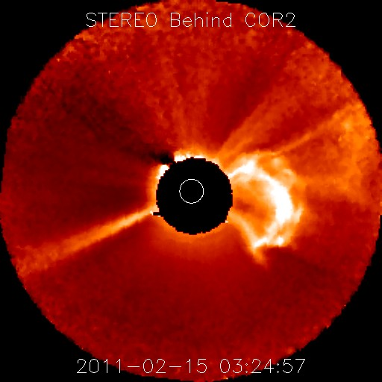
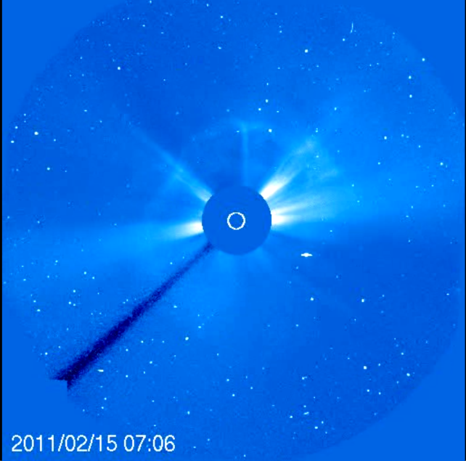
3D Coronagraph view for CME analysis
X2.2 flare 15 Feb 2011. Halo CME. +/- 6 hours target ?*
radial velocity
radius
latitude
longitude
* George Millward (CU/NOAA) Vic Pizzo, Doug Biesecker (NOAA), Curt de Koning (CU/NOAA) WSA-Enlil in Operations at the National Weather Service: Experiences, Results and Developments, SWW, 2012 http://www.swpc.noaa.gov/sites/default/files/images/u33/WSA_Enlil_SWW_2012.pdf

Slide 5
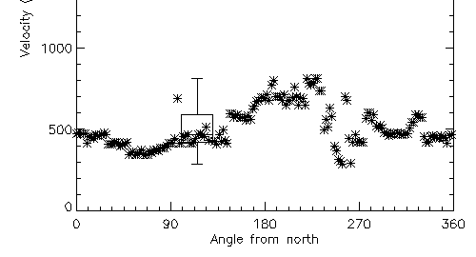
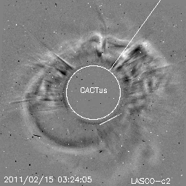
1D Coronagraph view for CME analysis
X2.2 flare 15 Feb 2011. Halo CME.
1D reliant upon empirical techniques (ROB SIDC Cactus - margin of error 285 to 811 km/s, median 469 km/s).
Plain-of-Sky velocity – NOAA SWPC RSGA 710 km/s.
Accuracy +/- 12 hours ?
Type II radio burst reports.
Space Weather Message Code: ALTTP2 Serial Number: 713 Issue Time: 2011 Feb 15 0348 UTC
ALERT: Type II Radio Emission Begin Time: 2011 Feb 15 0151 UTC Estimated Velocity: 556 km/s
Not always available or reliable –
Can pick up Alfén side shock-waves.

Slide 6
Monitoring CMEs in Heliosphere
Heliospheric Imager Stereo A
RAL Space / SECCHI Consortium
Images of the heliosphere from L5
would enable CME monitoring
From Sun to Earth.
And improve solar wind modelling.

Slide 7
Benefit of 3D view: Watching CMEs from Sun to Earth should reduce timing errors further - less than +/- 3 hours? Possible to modify prediction en-route. Increase confidence in prediction. Image Credit: NASA/STEREO/Scott Wiessinger https://www.nasa.gov/mission_pages/stereo/news/solarstorm-tracking.html

Slide 8
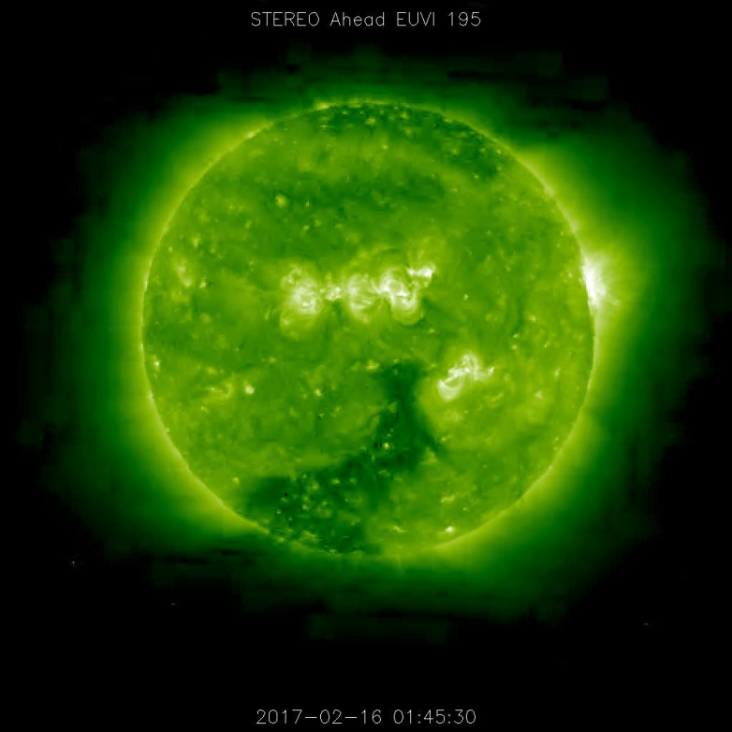
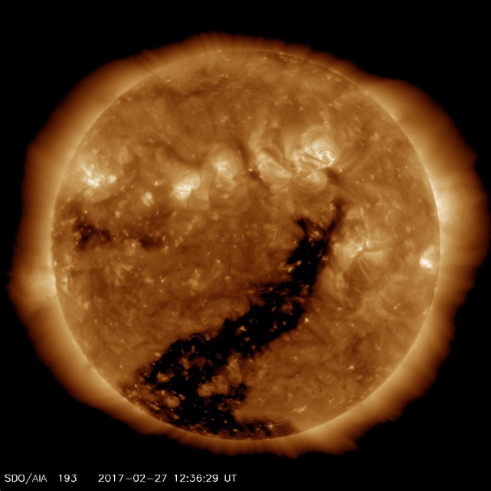
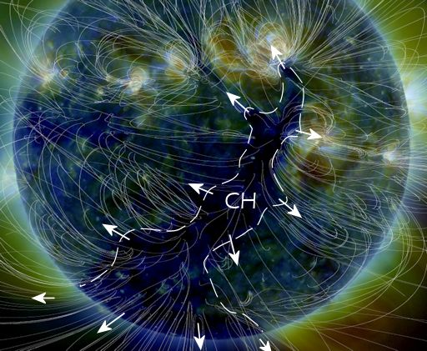
Solar wind from L5 EUV-Mag?
Development of Coronal Hole 66 from Stereo A to SDO.
Rotter, et al. Real-time solar wind prediction based on SDO/AIA coronal hole data, Solar Physics, 2015.

Slide 9
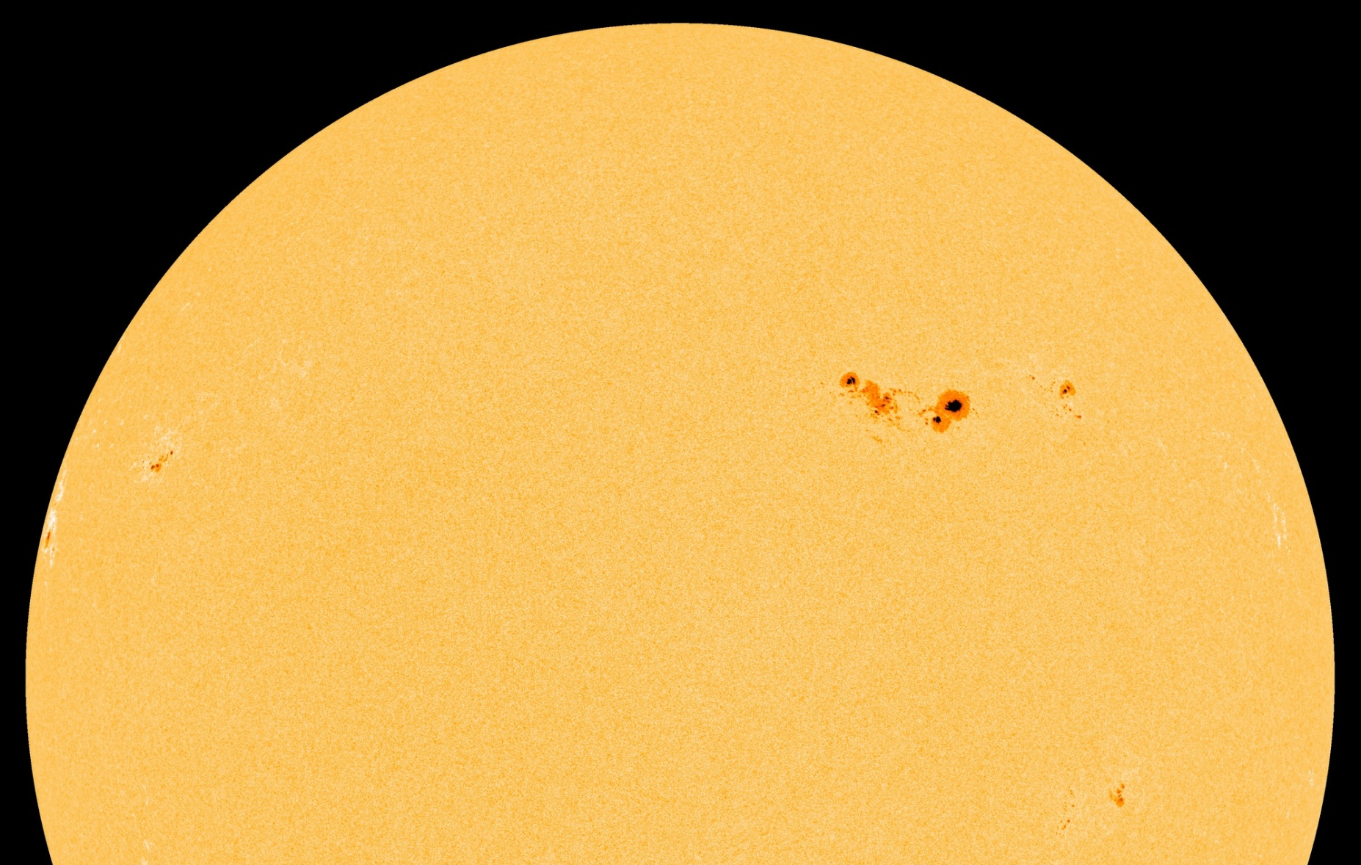
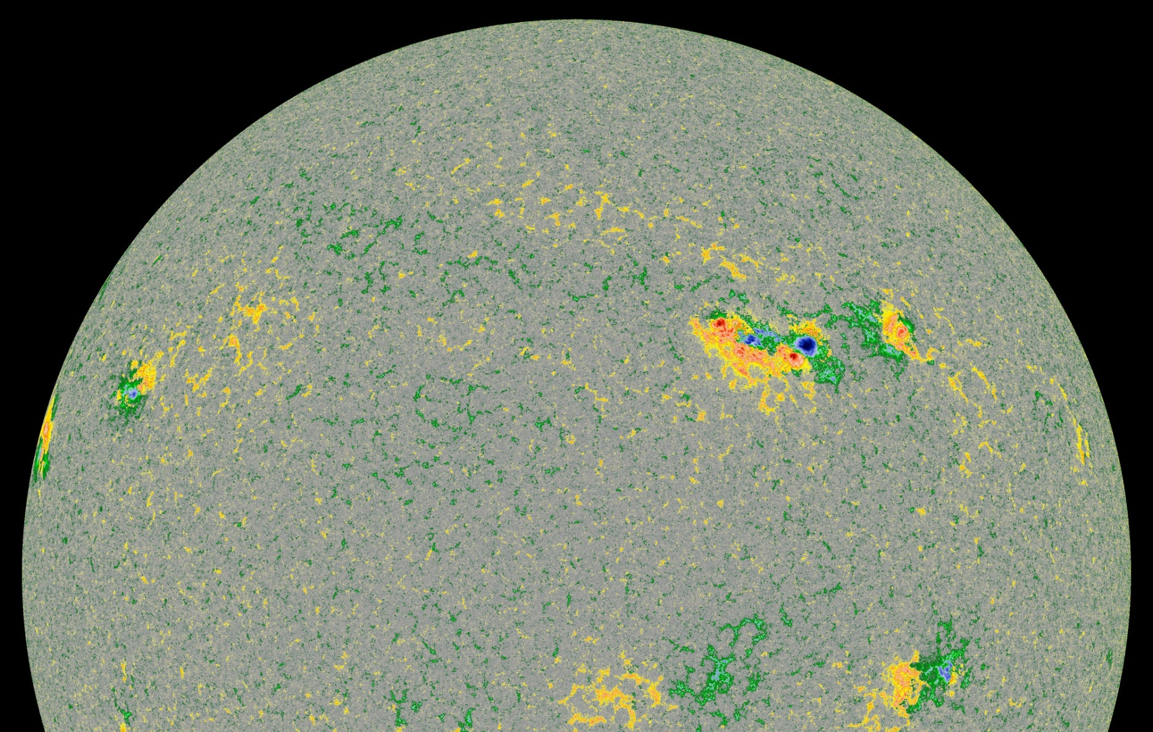
Accurate Sunspot Analysis
Necessary for Flare Forecasting
L5 Vis. & Mag. would enable accurate Sunspot classification near the eastern horizon.
Flare probabilities are based on McIntosh / Zurich & Mt Wilson Classification - Fkc βγδ etc. Feeds into CME likelihood.
Government and C.N.I. want 5-6 days notice of worrying sunspots – not possible with only 1D view – 2-3 days at present.
Impact upon Ionosphere D-Region, HF comms, GNSS etc.

